Slide 1
Analysis reason behind resigned from job
Prepared by Sahid

Slide 2
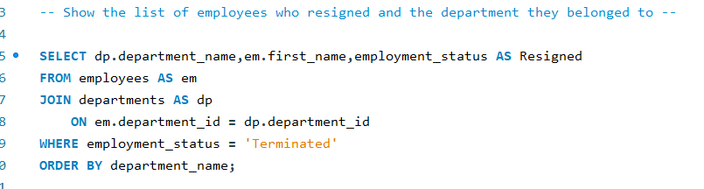
The list of employees who resigned and the department they belonged to
The SQL queries

Slide 3
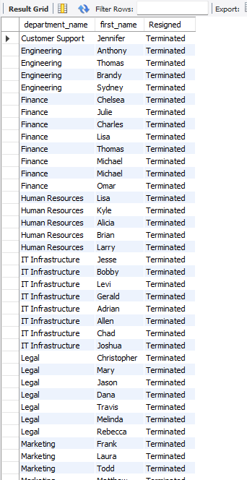
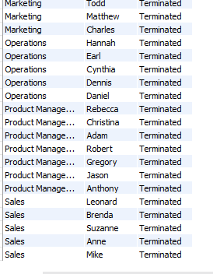
The output

Slide 4
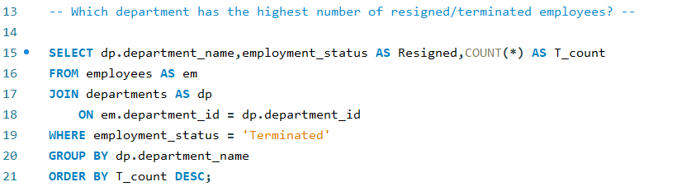
The highest number of resigned/ terminated employees from different department
The SQL queries

Slide 5
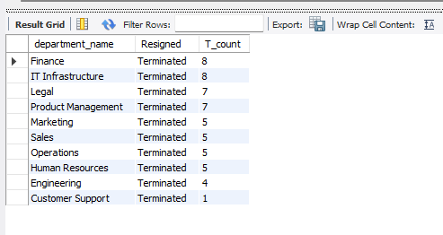
The Output
According to the output we can see the highest resigned count is ‘8’,which belongs to the “Finance” department and the lowest resigned count is ‘1’ that’s belongs to the “Customer Support” department

Slide 6
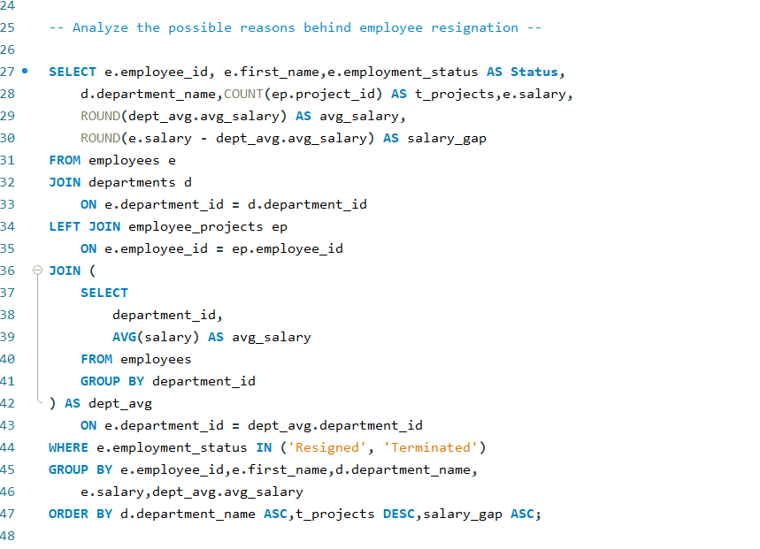
Analyzing the possible reasons behind employee resignation.
The SQL queries

Slide 7
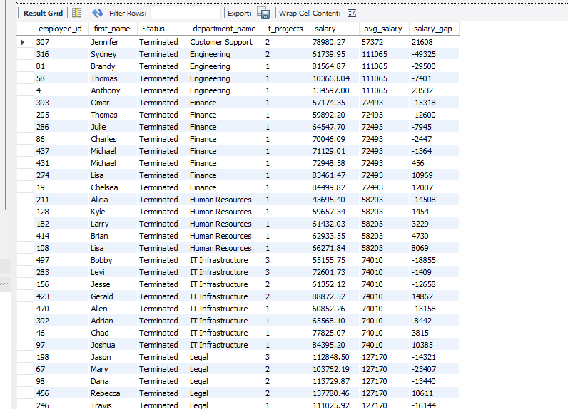
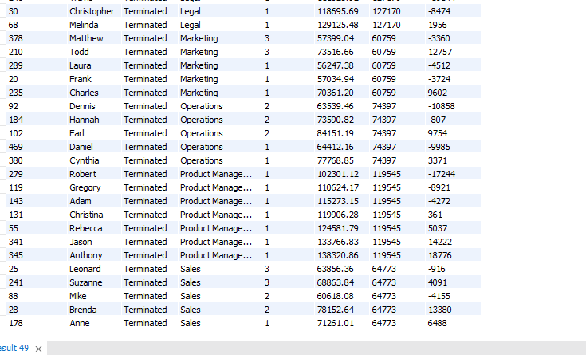
The output

Slide 8
The possible reasons behind employee resignation
According to the analyze output – there are several reason to resigned from the job, here are some in below,
A maximum amount of employees resigned from the only for the lowest salary
Some of them have lowest salary with multiple projects
Some of them may got better opportunities, even though some have good salary with lowest number of projects.

Slide 9
Conclusion
We have a datasets of hr_training ,where a list of employees from different department including terminated employees. We have analysis this datasets as per the table. There are defined employees salary, departments and projects they are doing. We have tried to find the reason behind those employees who got resigned by using some SQL queries and we get some several reason of resigned.

